Slide 1
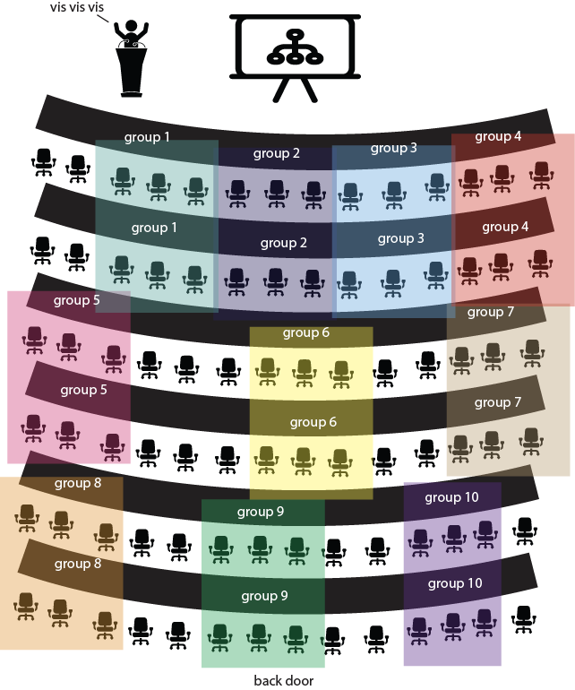
Find your group!

Slide 2
Data Models + Design SI649 / EECS548
September 19, 2016
http://si649.cond.org + Canvas

Slide 3
On the menu for today
Lecture
Expansion on data types + encoding
Expressiveness and Effectiveness
Discussion this week: Javascript

Slide 4
Quick review

Slide 5
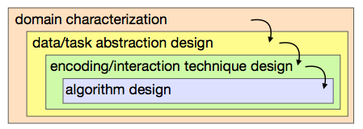
The skill we will develop
Identify the job, and job functions
Identify the visual comparisons that enable function
Identify the best visual encoding/idioms that support those comparisons
Identify the best way to implement

Slide 6
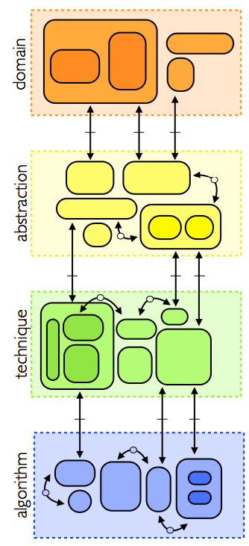
Munzner, 2009
Meyer et al., 2013

Slide 7
Meyer et al., 2013

Slide 8
Task
Data
Count
Abstract type
(nominal, ordinal, etc.)
Physical type
(int, float, etc.)
mapping
Visual encoding
Visual metaphor
Mark/Image
Count
Visual channel
Retinal Variables
Meyer et al., 2013

Slide 9
Given the data and tasks, are my choices in representation good?
domain
abstraction
technique
algorithm

Slide 10
Ok, so what’s the data?
Meyer et al., 2013

Slide 11
Quick tour of data
Data models
Relational
Statistical
Cube
Taxonomies of Data
Attributes of Data

Slide 12
N/O/Q – a taxonomy

Slide 13
Group activity In your groups, agree on answers to the quiz

Slide 14
Attribute Quality (Stevens/Ware)
Nominal
Labels (unordered)
Ordinal
Ordered
Interval
Gap comparison
Distance metric
Ratio
Size comparison
Interval with zero
Category data
Integer data
Real-number data
Stevens, On the Theory of Scales of Measurement
Ware, Information Visualization: Perceptions for Design

Slide 15
Attribute Quality
Nominal
Labels (unordered)
Ordinal
Ordered
Interval
Gap comparison
Distance metric
Ratio
Size comparison
Interval with zero
Nominal
Ordinal
Quantitative
Stevens, On the Theory of Scales of Measurement

Slide 16
Attribute Quality
Nominal
Labels (unordered)
Ordinal
Ordered
Interval
Gap comparison
Distance metric
Ratio
Size comparison
Interval with zero
Nominal (= and ≠)
Ordinal (<)
Quantitative (+,-,x, etc.)
Stevens, On the Theory of Scales of Measurement

Slide 17
N → O → Q
Nominal
only = and ≠
Ordinal
Everything that Nominal can do plus < and >
Quantitative
Everything that Ordinal can do and the ability to say how big the difference is or any other mathematical functions

Slide 18
Burned versus not-burned
Nominal
Ordinal
Quantitative
Cold, warm, hot…
-32.5, 9.1, …
Transformations possible across types

Slide 19
(Q)
(O)
(N)
Temperature | Hot/Warm/Cold | Burned/Not Burned
-50 | Cold | Not Burned
30 | Cold | Not Burned
300 | Hot | Burned
-10 | Cold | Not Burned
70 | Warm | Not Burned
-250 | Cold | Not Burned
2000 | Hot | Burned

Slide 20
Burned versus not-burned
Nominal
Ordinal
Quantitative
?
?

Slide 21
Group questions Given nominal (burnt/non-burnt) how do we get O/Q? What can’t we do?

Slide 22
(Q)
(O)
(N)
Temperature | Hot/Warm/Cold | Burned/Not Burned
30 | Cold | Not Burned
30 | Cold | Not Burned
300 | Hot | Burned
30 | Cold | Not Burned
30 | Cold | Not Burned
30 | Cold | Not Burned
300 | Hot | Burned

Slide 23
Burned versus not-burned
Nominal
Ordinal
Quantitative
?
?
Maybe: average temp of burned versus not-burned?
Transformations possible across types
(semantics a bit weird on some and might be “lossy”)

Slide 24
(Q)
(O)
(N)
Temperature | Hot/Warm/Cold | Burned/Not Burned
30 | Cold | Not Burned
30 | Cold | Not Burned
300 | Hot | Burned
30 | Cold | Not Burned
30 | Cold | Not Burned
30 | Cold | Not Burned
300 | Hot | Burned

Slide 25
Group questions? N/O/Q constrained by functions, Transformations constrained by initial choice …what’s the impact on our designs?

Slide 26
Roughly…
You’re constrained a bit by the data you’re given
But often it’s raw/quant, which means:
More often than not, you have to think about what comparisons you want to support
Should someone be able to tell that two pieces of data are different (alice ≠ bob)?
Should you be able to tell that one piece of data is larger (alice.height > bob.height)?
Should you be able to tell how much one piece of data is bigger (average(male height) is 5.5 inches more than average(female height))?

Slide 27
Which brings us back to…

Slide 28
Task
Data
Count
Abstract type
(nominal, ordinal, etc.)
Physical type
(int, float, etc.)
mapping
Visual encoding
Visual metaphor
Mark/Image
Count
Visual channel
Retinal Variables
Meyer et al., 2013

Slide 29
What’s a mark?

Slide 30
What do marks represent?
Entities
“things”
Alice and Bob, Males/Females, etc.
“properties of things”
Height of Alice and Bob
Relationships
Is a friend, is a parent, is in the same club, is after, etc.

Slide 31
Tableau Speak: Measures & Dimensions
Dimensions
Are the “countable” things
Are the “nameable” things (Bob, Alice, Everyone in SI649, the friendship between Alice and Bob)
Marks: blobs representing things
Measures are properties of the things
Usually numerical
Bob’s height, Alice’s GPA, the strength of the relationship between Alice and Bob
Visual representation: colors, sizes, etc.

Slide 32
Tableau Speak: Measures → Dimensions
Can transform measures to dimensions
Example:
Alice & Jane have a 4.0 GPA, Bob has a 3.0
Names are dimensions, GPA is measure
Make GPA dimension
Jane
Bob
Alice
3.0
4.0
3.0
4.0
(kinda boring)

Slide 33
Tableau Speak: Measures → Dimensions
Can transform measures to dimensions
Example:
Alice & Jane have a 4.0 GPA, Bob has a 3.0
Names are dimensions, GPA is measure
Make GPA dimension and count the measure
Jane
Bob
Alice
3.0
4.0
4.0
3.0

Slide 34
How do we transmit and receive visual information?

Slide 35
Bertin’s Semiology
Images perceived as a set of signs
Sender encodes information in signs
Receiver decodes information from signs
Encode quantitative variables
A,B, and C and distinguishable
B is between A and C
BC is twice as long as AB
+C
+B
+A

Slide 36
These are the set of facts this image expresses
Encode quantitative variables
A,B, and C and distinguishable
B is between A and C
BC is twice as long as AB
+C
+B
+A

Slide 37
Things we can manipulate
The marks
The visual properties of the marks

Slide 38
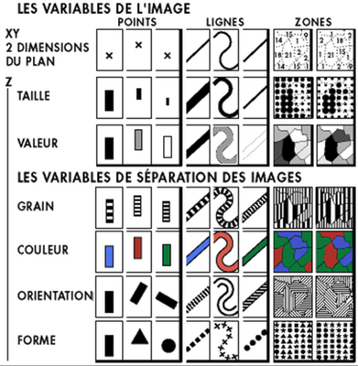
Visual Encoding Variables
Position (2D)
Size
Value
Texture
Color
Orientation
Shape
(Transparency, Blur, etc.)

Slide 39
Name | Score
A | 1
B | 5
C | 2
Sender “Encodes” using Functions/Rules
Draw a bar for every person
Bar’s height should be 1 inch for every point
Group question: Why is encoding “rule based?”

Slide 40

Name | Score
A | 1
B | 5
C | 2
Name | Score
A | 1
B | 5
C | 2
Sender “Encodes” using Functions/Rules
Receiver “decodes” using Functions/Rules
Group question: Just seeing the figure, is there enough information to decode?

Slide 41
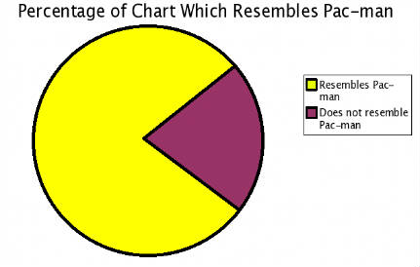
Name | Score
A | 1
B | 5
C | 2
Name | Score
A | 1
B | 5
C | 2
Sender “Encodes” using Functions/Rules
Receiver “decodes” using Functions/Rules
5
4
3
2
1
A B C

Slide 42
Name | Score
A | 1
B | 5
C | 2
Name | Score
A | 1
B | 5
C | 2
Draw a circle for every person
Set 1 to white, 5 to red, interpolate everything between
Sender “Encodes”
(bar chart)
Sender “Encodes” (color dots)
5
C
4
3
A
2
1
B
A B C
1
5

Slide 43
Name | Score
A | 1
B | 5
C | 2
Name | Score
A | 1
B | 5
C | 2
Name | Score
A | 1
B | 5
C | 2
Sender “Encodes”
(bar chart)
Sender “Encodes” (color dots)
Sender “Encodes” (size stars)
5
C
C
4
3
B
A
2
1
A
B
A B C
1
5
1
2
3
4
5

Slide 44
Which is better?
99% of this class is on making the right choice…
Sender “Encodes”
(bar chart)
Sender “Encodes” (color dots)
Sender “Encodes” (size stars)
5
C
C
4
3
B
A
2
1
A
B
A B C
1
5
1
2
3
4
5

Slide 45
Given the data and tasks, are my choices in representation good?
domain
abstraction
technique
algorithm

Slide 46
Given the data and tasks, are my choices in representation effective and expressive?
domain
abstraction
technique
algorithm

Slide 47
Expressive versus Effective
A graph expresses…
The statistical “facts” that we can infer from the diagram
A graph does not express…
The statistical “facts” that are impossible to infer from the diagram

Slide 48
Group questions
What is expressed here?
What is not expressed here?

Slide 49
Expressive versus Effective
Important difference:
(Im)possible to infer has to do with expressiveness
Easy/hard to infer has to do with effectiveness

Slide 50
Group questions
Which is more expressive (expresses more facts)?
Which is more effective?
Total size: 17

Slide 51
ID | Value
A | 5
B | 4
C | 3
D | 2
E | 3
Total size: 17
ID | Value
A | 5
B | 4
C | 3
D | 2
E | 3

Slide 52
ID | Value
A | 5
B | 4
C | 3
D | 2
E | 3
Total size: 17
Both tables are the same, so I can answer the exact same set of questions!
Is A > B?
How much bigger is B than C?
What is the 3rd largest value?
Are C and E the same?
And so on…

Slide 53
Group questions
They are equally expressive!
Total size: 17

Slide 54
ID (N) | Value (Q)
A | 5
B | 4
C | 3
D | 2
E | 3
Total size: 17
Don’t forget, expressiveness power is not about the actual data!
ID (N) | Value (Q)
A | 5
B | 4
C | 3
D | 2
E | 3

Slide 55
Group questions
How about now?
Total size: 17

Slide 56
ID | Value
A | 5
B | 4
C | 3
D | 2
E | 3
Total size: 17
ID | Value
A | 5
B | 4
C | 3
D | 2
E | 3

Slide 57
Total size: 17
Can no longer answer: Is A>B? or how much bigger is A relative to B?

Slide 58
Effectiveness?
You need to ask: “effective for what?”
What percentage of the while is A?
How much bigger is A relative to B?
Total size: 17

Slide 59
Name | Score
A | 1
B | 5
C | 2
Name | Score
A | 1? 1.1?
B | 4.9? 5?
C | 1.9? 2? 2.1?
Name | Score
A | 1
B | 5
C | 2? 3?
Decode (bar chart)
Decode (color dots)
Decode (size stars)
5
1
C
5
C
4
3
4
A
B
2
3
1
A
B
2
A B C
5
1
Name | Score
A | 1
B | 5
C | 2
Effectiveness: difference between true answer and what the person says/sees
True answer:

Slide 60
Name | Score
A | 1
B | 5
C | 2? 3?
Name | Score
B | 5
C | 2? 3?
Decode (size stars)
Encode/Decode
(size stars++)
5
C
5
C
Draw a star for every person
Set size proportional to score, throw away scores <= 1
4
4
B
B
3
3
2
A
2
1
Name | Score
A | 1
B | 5
C | 2
Expressiveness: difference between amount of information we can decode
True answer:

Slide 61
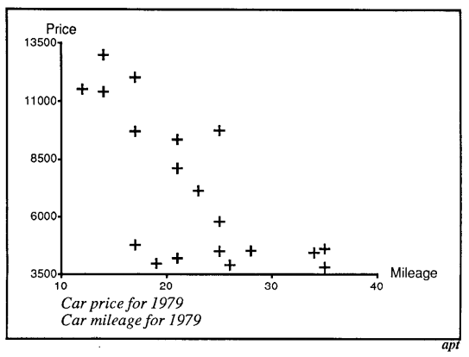
Expressiveness
Expresses relation between mileage and price
Does not expresses relation of specific cars

Slide 62
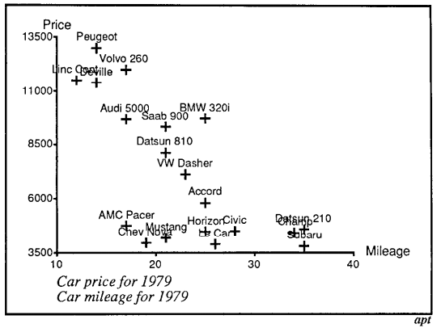
Expressiveness
Expresses relation between mileage and price + supports comparison of cars
Over-expresses if we don’t care about specific cars

Slide 63
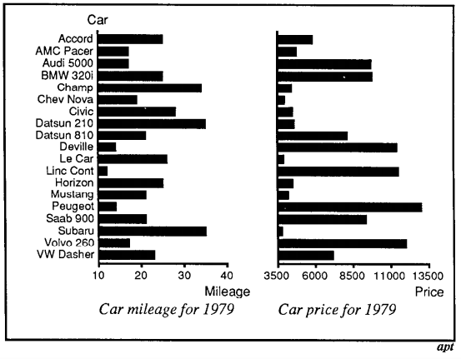
Effectiveness
Expressive, but not effective!

Slide 64
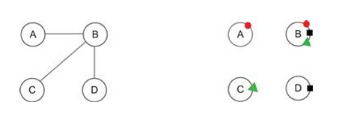
From Ware, 2012
What’s expressed?
What’s expressed?
What’s the difference?
Effectiveness (we’ll get into why next lecture)

Slide 65
Remember
To answer expressiveness question:
Figure out what data is encoded
Distinguish between what is possible/impossible
Not important what is easy/hard
To answer effectiveness question:
First figure out what you need to be effective at…
And then you can start applying design philosophy, perceptual rules, and instinct
How much easier is it to decode specific facts?

Slide 66
So what’s effective?

Slide 67


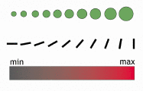
There are good and bad choices depending on data/task (effectiveness)
Nominal (= and ≠)
Ordinal (<)
Quantitative (+,-,x, etc.)

Slide 68


Bertin’s “Levels of Organization”
Position | N | O | Q
Size | N | O | Q
Value | N | O | Q
Texture | N | O
Color | N
Orientation | N
Shape | N
O:
Q:
Not as good
Adapted from Heer

Slide 69
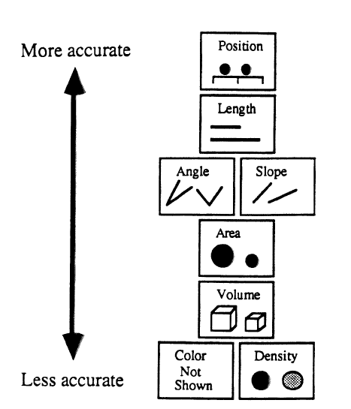
Mackinlay, Automating the Design of Graphical Presentations of Relational Information

Slide 70
Mackinlay’s Criteria of algorithm
Expressiveness
A set of facts is expressible in a visualization if the visualization expresses all the facts in the set of data and only the facts in the data
Effectiveness
A visualization is more effective if the information conveyed by one visualization is more readily perceived than the information in another visualization

Slide 71
The facts and nothing but the facts…
Nominal: (alice ≠ bob)?
Ordinal: (alice.height > bob.height)?
Quantitative: (average(male height) is 5.5 inches more than average(female height))?
bob
alice
shortest
tallest
alice
bob
Average height
12 inches
18
24
30
36
42
48
54
60

Slide 72
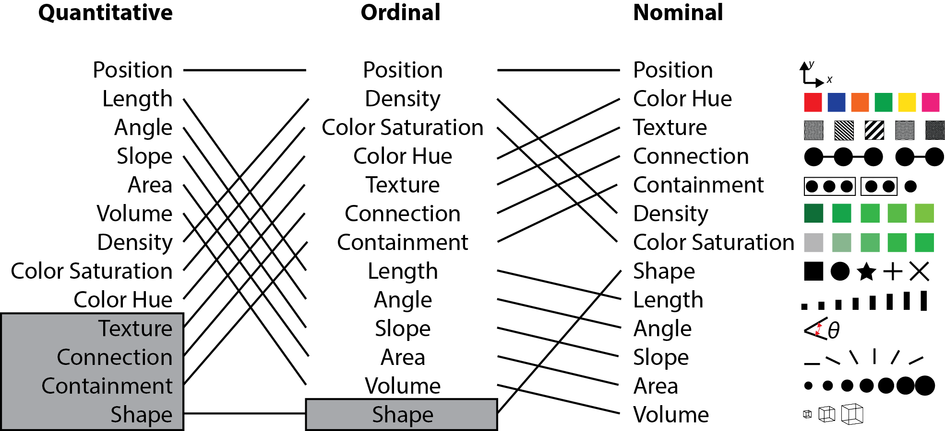
Be greedy:
pick best rep. given your most important comparison,
cross off list,
continue with next most important
From Mackinlay
Notes:
Gray = not relevant

Slide 73
Given the data and tasks, are my choices in representation effective and expressive?
domain
abstraction
technique
algorithm

Slide 74
Let’s critique some vis
Look at the visualization
Identify the data used (and “type”)
Identify what you think they want to express
Identify what you think they don’t want to express
Determine if the encoding is most effective
This is a bit backwards… we’re guessing what they want to express based on their graphical choices (doesn’t mean they made good choices)

Slide 75
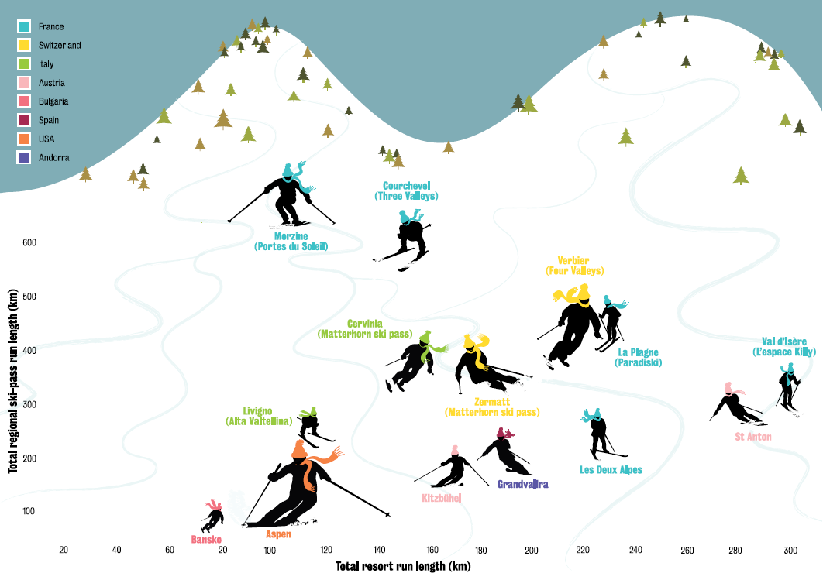
What are the variables? (and their types)
What is being expressed?
What isn’t?
What is or isn’t effective given the vis?
Skier height → more expensive
Notes:
Thinking of heading to Verbier this winter? You’ll find better value at Courchevel. We collected data from 15 ski resorts: total length of runs (km), total length of runs for the regional ski pass, if available, and cost of a six-day regional peaktime ski pass (named in brackets after the relevant resorts). To “read” our mountain: the further to the right skiers are, the greater the total length of runs at that resort; the higher up they are, the larger the ski region, and the taller the skiers, the greater the cost of a ski pass. The ultimate resorts - by these criteria - are higher, but with a shorter skier (Morzine does well). It’s not surprising to find Verbier at altitude, but the taller skier denotes pricey skiing. Bear in mind we’ve only included ski areas that are linked by lifts (hence Banff isn’t included, and Aspen doesn’t perform as well as you might expect because its mountains are a bus ride apart).
Had we allowed bus-linked regions, Aspen - with Les Deux Alpes and St Anton - would have carved up the competition. Austrian resorts are not as expensive as French or Swiss ones, and skiing in Bulgaria is cheap, but you might get tired of the same old scenery.

Slide 76
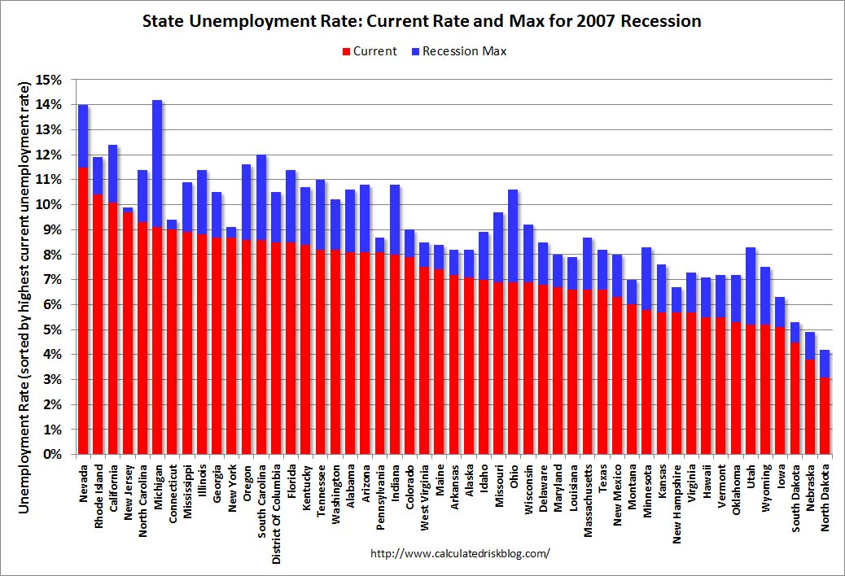
What’s the table?
What facts does this visualization express (or not)?
Is the encoding effective?

Slide 77
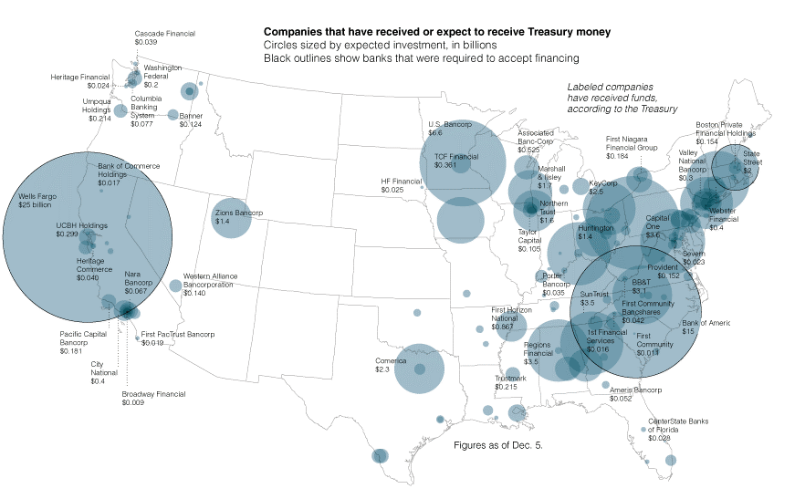

Slide 78
You’ll get to do this a lot
You’ll be repeating this pattern over and over
What’s the data/use?
What do I want to express?
What’s the most effective way of expressing it?
But your vocabulary will grow
Many more task types
Many more encodings/idioms/interaction patterns
Many more mechanisms
Meyer et al., 2013

Slide 79
See you soon…

